Slide 1
Project on twitter text mining
GROUP A
AADARSHA CHAPAGAIN
JYOTI SHUKLA
PIYUSH BHATIA
PRITI BHALE
RISHI PHANEENDRA VARMA
SREYA TREESA JOHNY

Slide 2
Introduction
Internet generating huge data everyday
Need of converting data to meaningful information
Used NLP libraries to accomplish the objective

Slide 3
Steps
Build up the corpus
Analyze the Sentiment
Visualize the result

Slide 4
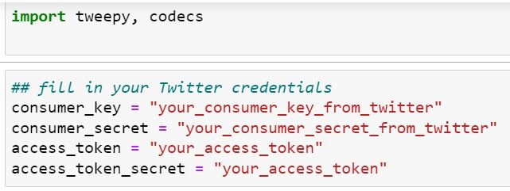
Build corpus
We use tweepy library
Write tweets to text file

Slide 5
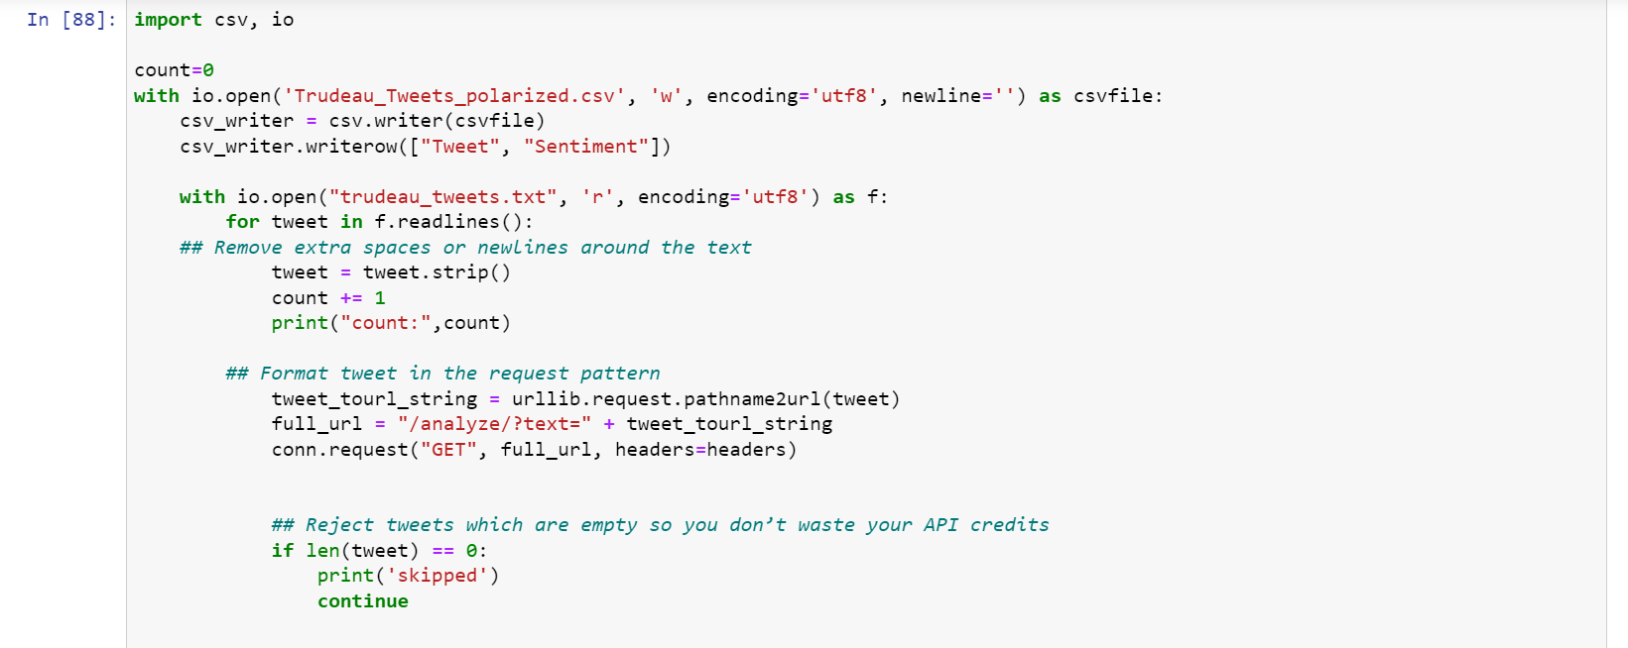
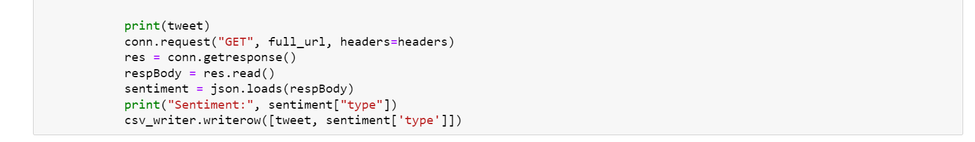
Analyze sentiment
RAPID AI used for sentiment analysis

Slide 6
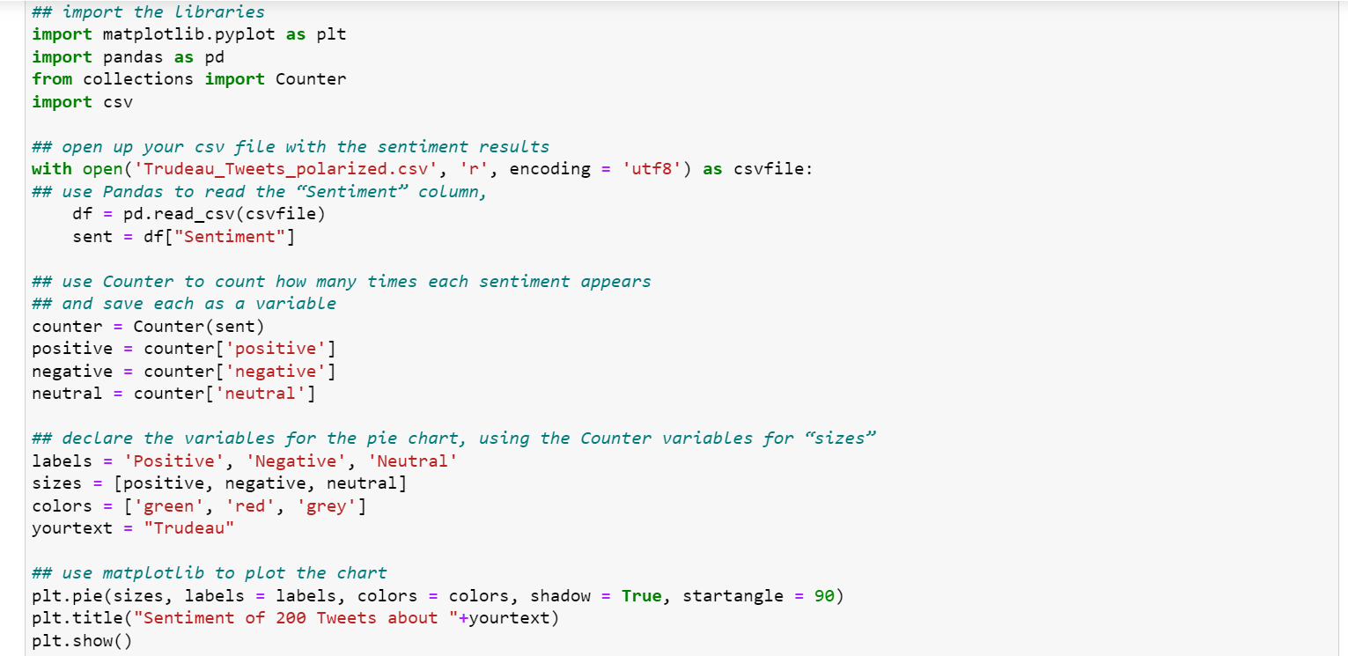
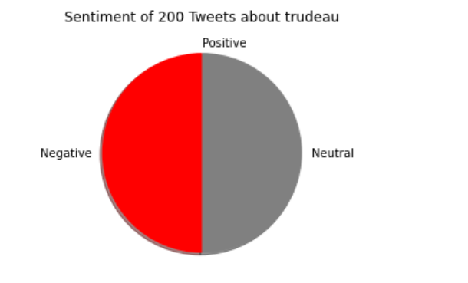
Visualize results
Used matplotlib

Slide 7
Thank you

